Slide 1
Paxos in TLA+
易星辰
2018.4.20

Slide 2
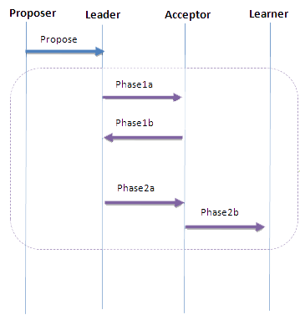
过程
三个角色
Proposer、Acceptor、Learner
执行过程

Slide 3
抽象建模
变量
Value: 要选择值的集合
Acceptor: 所有接收者的集合
Ballot: 投票编号的集合
msgs: 所有消息的集合
maxBal: 每个Acceptor在Phase1b回复承诺对应编号
maxVBal, maxVal: 每个Acceptor在phase1b回复的决议

Slide 4
抽象建模
动作抽象
Phase1a、Phase1b、Phase2a、Phase2b
消息抽象
每个动作传递一个消息
枚举

Slide 5
Implication
P => Q (p implies Q)
IF P THEN Q
ELSE TRUE

Slide 6
TEMPORAL FORMULAS
An assertion about behaviors
it is true or false of a behavior
whether the behavior is a possible execution
A behavior of the algorithm
a sequence s1 -> s2 -> s3 -> …
Init is true in s1
for any pair si -> si+1, Next is true

Slide 7
Define spec
paxos spec(Spec) has two formula
Init formula: Init
next-state formula: Next
Spec should be true on s1 -> s2 -> … iff(if and only if)
Init is true on s1
Next is true on si -> si+1 for all i
Spec == Init /\ []Next
Spec == Init /\ [][Next]_<v1, …, vn>
[]Next (Always Next)

Slide 8
Model Check
CP
For any rounds i and j with j < i, if a value v has been chosen or might yet be chosen in round j, then no acceptor can vote for any value except v in round i.
For any rounds i and with j < I, if an acceptor has voted for v in round i, then no value other than v has been or might ye be chosen in round j.

Slide 9
Liveness
WF(A)
if A ever becomes forever enabled, then an A step must eventually occur.

Slide 10
Q&A

